Slide 1
Discrete Mathematics
South China University of Technology
1

Slide 2
Chapter 7. Relations
Equivalence Relations
Section 7.5
2

Slide 3
Contents
1
Equivalence Relations
2
Equivalence Class
3
Equivalence and Partitions
3

Slide 4
Equivalence Relations
4

Slide 5
§7.5: Equivalence Relations
Definition: An equivalence relation on a set A is any binary relation on A that is
reflexive,
symmetric,
and transitive.
E.g., = is an equivalence relation.
But many other relations follow this pattern too

Slide 6
§7.5: Equivalence Relation
Example. For any function f:A→B, the relation “have the same f value”, or
{(a₁,a₂) | f(a₁)=f(a₂)} is an equivalence relation,
Example. let m=“mother of” then =_{m} = “have the same mother” is an equivalence relation

Slide 7
Equivalence Relation Examples
“Strings a and b are the same length.”
“Integers a and b have the same absolute value.”

Slide 8
Equivalence Relation Examples
How about: R(f,g) ⇔ f(2)=g(2) ?
Yes.
Reflexivity: f(2)=f(2), for all f
Sym: f(2)=g(2) implies g(2)=f(2)
Trans: f(2)=g(2) and g(2)=h(2) implies f(2)=h(2).

Slide 9
Equivalence Relation Examples
How about R(f,g) ⇔ f(1)=g(1)∨f(2)=g(2) ?
No. Counterexample against transitivity:
f(1)=a, f(2)=b
g(1)=a, g(2)=c
h(1)=d, h(2)=c
Notes:
f resembles g
g resembles h
f doesn’t resemble h

Slide 10
Example 4
Congruence Modulo m
Let m be a positive integer with m>1. Show that the relation
R = { (a,b) | a = b (mod m) }
is an equivalence relation on the set of integers.

Slide 11
Equivalence Class
11

Slide 12
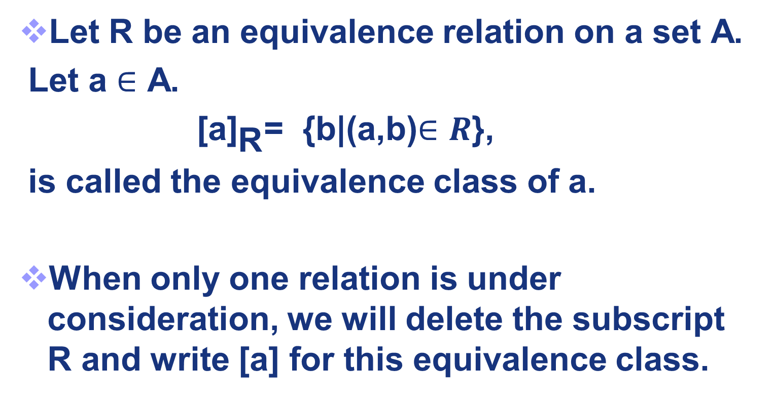
Definition 2
Let R be an equivalence relation on a set A.
Let a $∈$ A.
${\text{[}\text{a}\text{]}}_{\text{R}}$= {b|($\text{a}$,b)$∈R$},
is called the equivalence class of a.
When only one relation is under consideration, we will delete the subscript R and write [a] for this equivalence class.

Slide 13
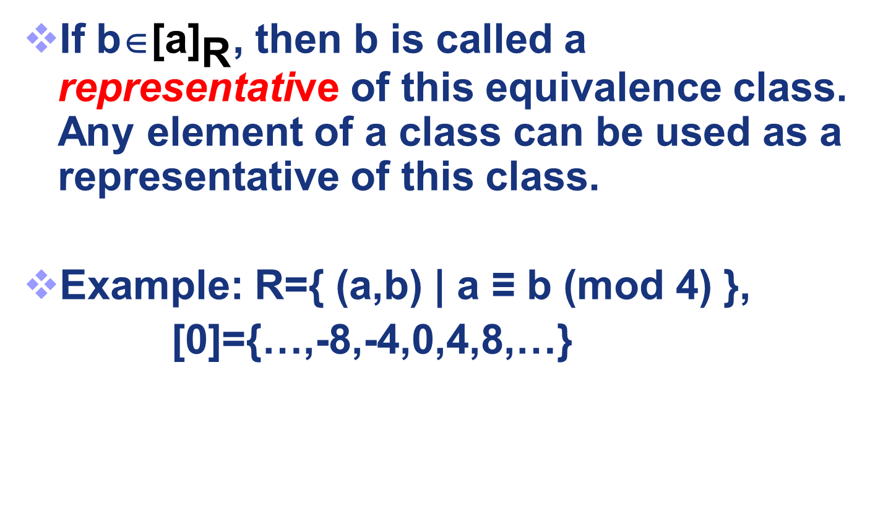
If b∈${\text{[}\text{a}\text{]}}_{\text{R}}$, then b is called a representative of this equivalence class. Any element of a class can be used as a representative of this class.
Example: R={ (a,b) | a ≡ b (mod 4) },
[0]={…,-8,-4,0,4,8,…}

Slide 14
Equivalence Classes
If aRb , then aRx ⇔ bRx.
Proof:
1. L2R.
aRb, aRx.
aRb ⇒ bRa (symmetry).
bRa, aRx ⇒ bRx by transitivity
2. R2L.
aRb, bRx ⇒ aRx, by transitivity.
Notes:
Draw graph

Slide 15
Equivalence Classes
We now know that aRb ⇒ { x | aRx } = { x | bRx }.
ie, aRb ⇒ [a]=[b] .
it does not matter which representative of an equivalence class you take as your starting point

Slide 16
Equivalence Class Examples
“(Strings a and b) have the same length.”
Suppose a has length 3. Then [a] = the set of all strings of length 3.
“(Integers a and b) have the same absolute value.”
[a] = the set {a, −a}

Slide 17
Equivalence and Partitions
17

Slide 18
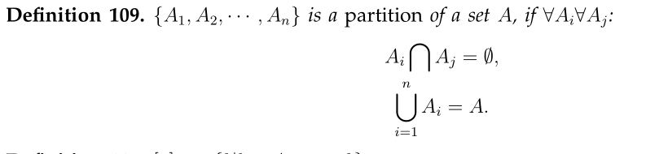
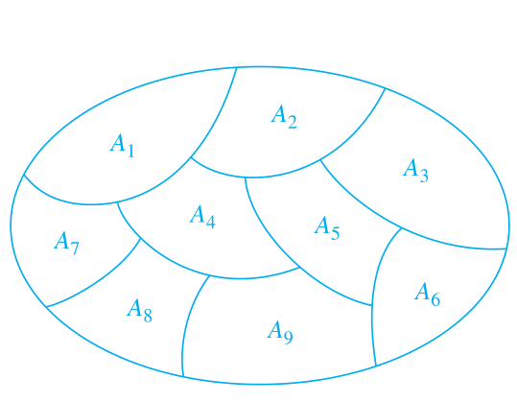
Partitions
For example, consider the set A={1,2,3,4,5,6}
its partition {{1,2,3},{4},{5,6}}

Slide 19
Partitions and equivalence classes
We sometimes say:
A partition of A induces an equivalence relation on A
An equivalence relation on A induces a partition of A

Slide 20
Equivalence relation to Partitions
Theorem 1 Let R be an equivalence relation on a set A. These tatements are equivalent:
a R b
[a] = [b]
[a] ∩ [b] ≠ Ø

Slide 21
Equivalence relation to Partitions
Theorem 2[Equivalence ⇒ Partitions]. Let R be an equivalence relation on a set
S={s₁, s₂, s₃, …., s_{n}}.
Then the equivalence classes
{[s₁], [s₂], [s₃], …., [s_{n}]}
of R form a partition.

Slide 22
Equivalence relation to Partitions
E.g. in (N, =mod4):
{[0], [1], [2], [3], [4], [5],……..}
= {[0], [1], [2], [3]}

Slide 23

Partitions to Equivalence relation
Theorem 3[Partitions ⇒ Equivalence]. Given a partition { A_{i} | i ∈ I} of the set S, there is an equivalence relation R that has the sets Ai, i ∈ I, as its equivalence classes.
Proof:
we construct R :
It is trivial to see R is an equivalence relation

Slide 24
Example 8
R is an equivalence relation produced by the partition {{1,2,3},{4},{5,6}} of A={1,2,3,4,5,6} .
List the elements of R?
R= {1,2,3}² U{4} ²U{5,6} ²
={(1,1),(2,2),(3,3),(1,2),(1,3),(2,3),(2,1),(3,1),(3,2) ,(4,4), (5,5),(6,6),(5,6),(6,5) }

Slide 25
Please prove the following theorem.

Slide 26
Homework
2 c) e)
11
20 b,e
26

Slide 27
End of Section 7.5
Click to edit company slogan .
27

